Slide 1

DriverPass System Analysis
Austin Sonka

Slide 2

System Requirements
1. Offer three different driving packages
2. Allow customer change, book or cancel appointments
3. Have online practice exams
4. Will be web based
5. Fast enough loading times
Notes:
The DriverPass will offer three different packages for customer to choose from. Along with the system, the customer will have access to change, book, or cancel appointment's. Inside the system, they can practice exams all from a fast web based application.

Slide 3
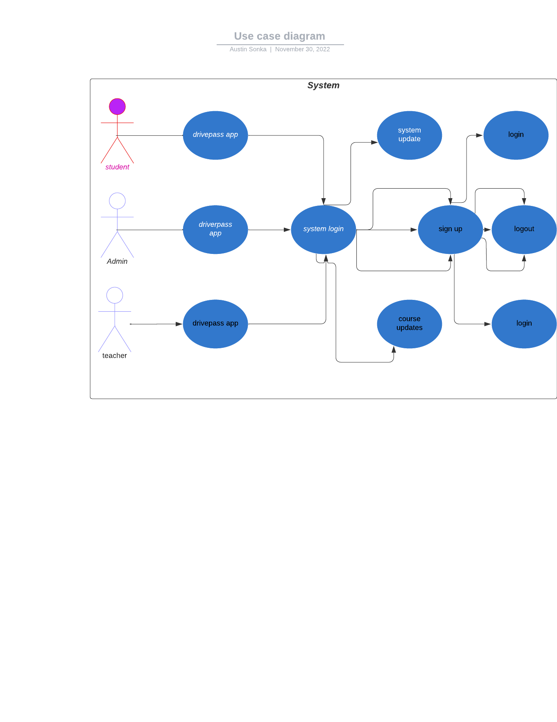
Use Case Diagram
Notes:
1. Different actors?
student, teacher, admin and the system.
2. use cases did you capture?
some cases I captured are the ones where the software links up the relationships and functions together. Doing this results in it working good together.
3. Capture all the functionality of the system?
I believe so in having all the main parts of the systems completed and show on the diagram.
4. Technical requirements?
I suppose laptop and some wifi or 5G. both these things are needed to make the diagram and function.

Slide 4
Activity Diagram
Notes:
It starts with the user on the website then they will login. If it is wrong they will be asked to try again. If they succeed then they will get granted permission to access website.

Slide 5
Security
Track when a user made a change
If user forgot passcode then they can reset through their email
Accounts will be disabled after 3 wrong attempts
User will require username and password to login to system
The cloud will be the main data exchange
Notes:
When thinking about security we really wanted to knock the ball out of the park with this one. So keep this in mind we set up a cloud server to be the main engine of information to come and go between the system and user resulting in fast results and safe. When a user is trying to login they have three attempts to get the correct passcode or they will be locked out of the system. However if they forgot their passcode then can easily reset though email.

Slide 6
System Limitations
No budget given
Time restriction of 5 months
Needs internet connection
Notes:
We were given no budget, this gives us a disadvantage of not knowing what they can purchase, We also have a time restriction of 5 months, so we would need to hire many people to get this done to make sure it has quality. The web based system is in a web version so it will need to have internet access.

